Slide 1
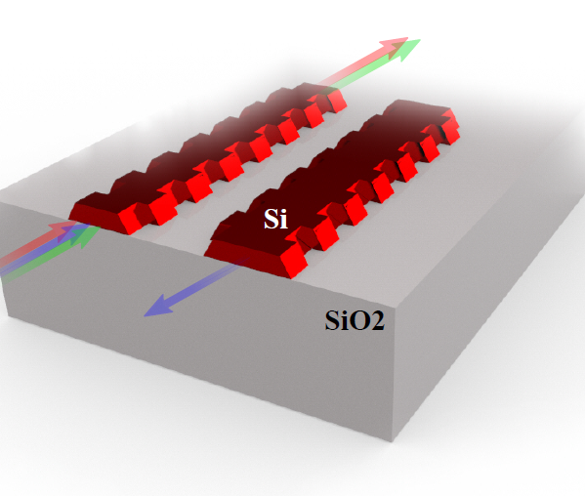
Understanding Contra-directional couplers photonic band diagrams
Mustafa Hammood

Slide 2
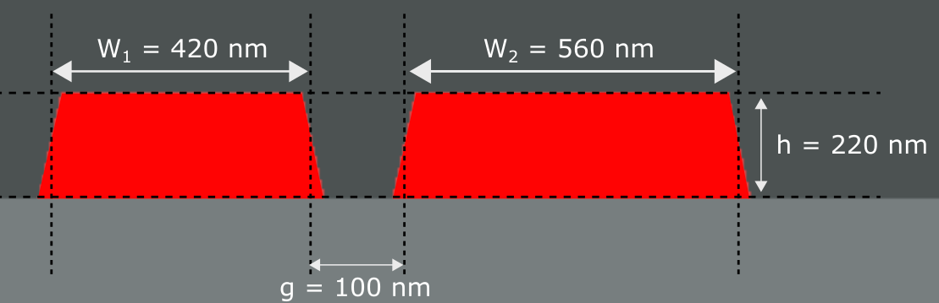
Waveguides Geometry
Cross Section View

Slide 3
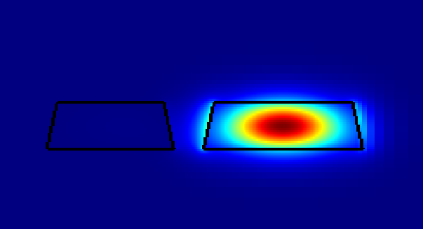
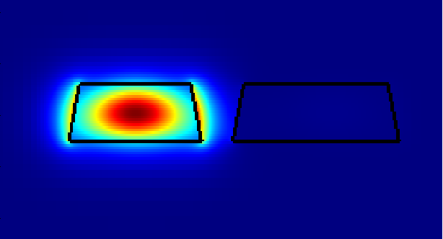
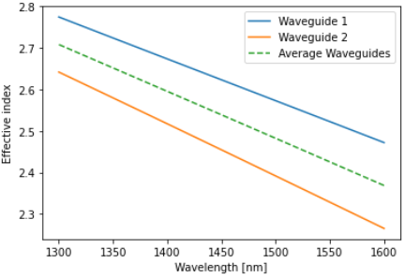
Modes in the system near λ=1550 nm

Slide 4
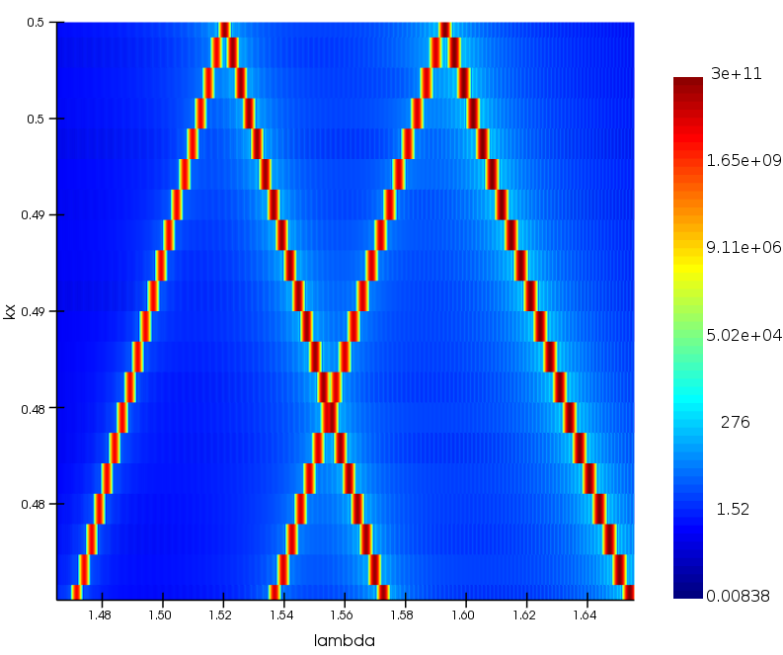

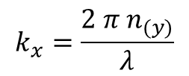
Photonic Band Structure near λ=1550 nm
$$k_{x0}=\frac{π}{Λ}=0.5$$
$$k_{x}=\frac{2 π{ n}_{(y)}}{λ}$$

Slide 5
Photonic Band Structure near λ=1550 nm
TE0

Slide 6
Photonic Band Structure near λ=1550 nm
TE1

Slide 7
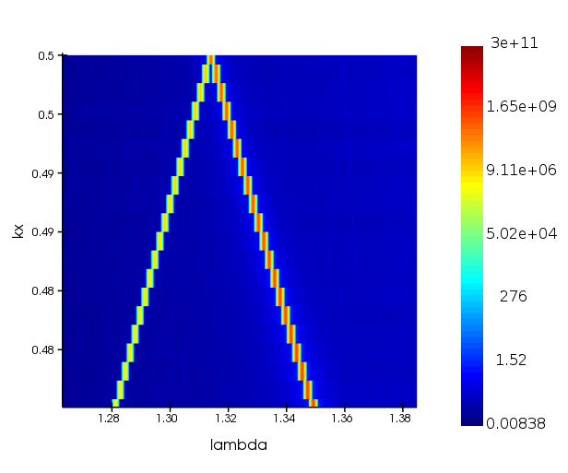

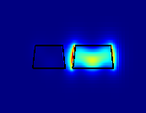
Photonic Band Structure near λ=1310 nm
Slot

Slide 8
Perturbing the system
What happens when the waveguides are corrugated periodically?

Slide 9
Top View
Unperturbed Waveguides
Waveguide 1
Waveguide 2

Slide 10
Top View
perturbed Waveguides
Waveguide 1
Waveguide 2

Slide 11

Top View
perturbed Waveguides
Waveguide 1
Waveguide 2
$$Λ$$

Slide 12
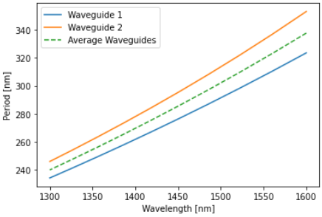
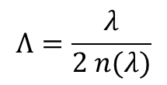
Modes in the system near λ=1550 nm
$$Λ=\frac{λ}{2 n(λ)}$$

Slide 13






Modes in the system near λ=1550 nm
$λ_{wg2}=$1511.4 nm
$$Λ=\frac{λ}{2 n(λ)}$$
$λ_{CDC}=$1545.6 nm
$λ_{wg2}=$1516.8 nm
$λ_{wg1}=$1582.9 nm
$λ_{CDC}=$1551.9 nm
$λ_{wg1}=$1589.2 nm

Slide 14
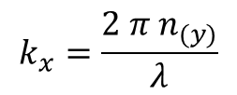

Photonic Band Structure near λ=1550 nm
Unperturbed Waveguides
$$k_{x0}=\frac{π}{Λ}=0.5$$
$$k_{x}=\frac{2 π{ n}_{(y)}}{λ}$$

Slide 15
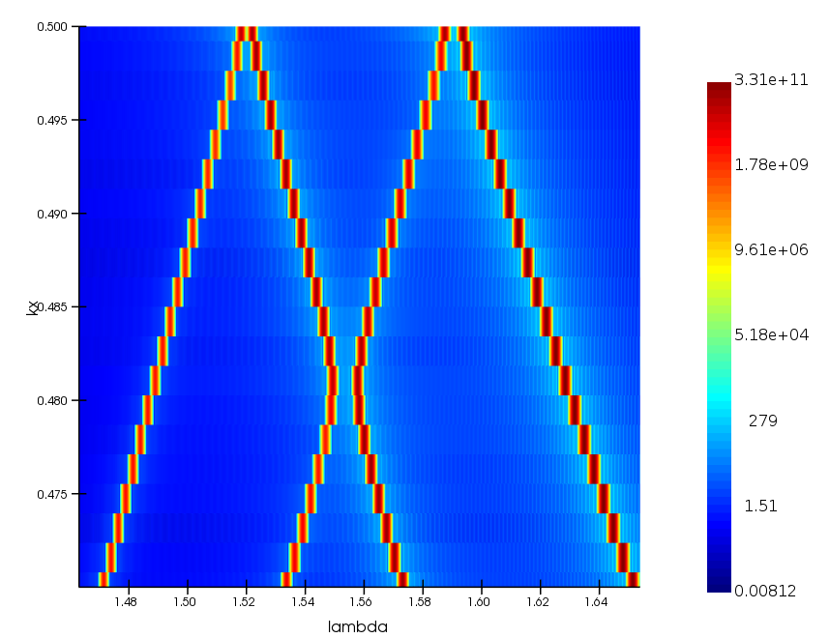
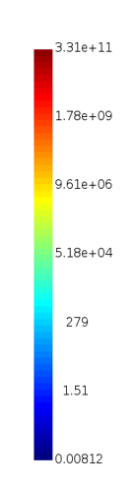
Photonic Band Structure near λ=1550 nm
perturbed Waveguides
$$k_{x0}=\frac{π}{Λ}=0.5$$
$$k_{x}=\frac{2 π{ n}_{(y)}}{λ}$$

Slide 16
Photonic Band Structure near λ=1550 nm
TE0

Slide 17
Photonic Band Structure near λ=1550 nm
Waveguide’s
Self-reflection
TE0

Slide 18
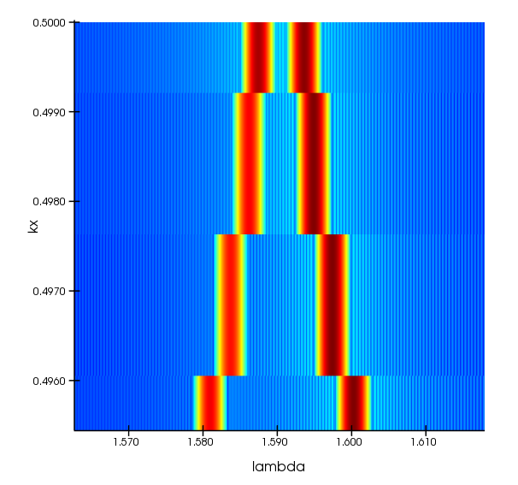
Photonic Band Structure near λ=1550 nm
Δλ = 6.2 nm
λ0 = 1590.5 nm
Waveguide’s
Self-reflection
TE0

Slide 19
Photonic Band Structure near λ=1550 nm
TE1

Slide 20
Photonic Band Structure near λ=1550 nm
Waveguide’s
Self-reflection
TE1

Slide 21
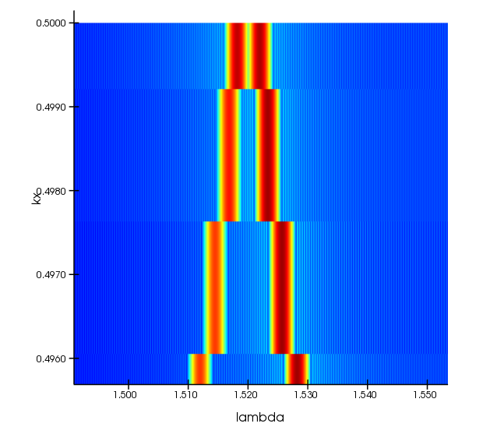
Photonic Band Structure near λ=1550 nm
Δλ = 3.75 nm
λ0 = 1520 nm
Waveguide’s
Self-reflection
TE1

Slide 22
Photonic Band Structure near λ=1550 nm

Slide 23
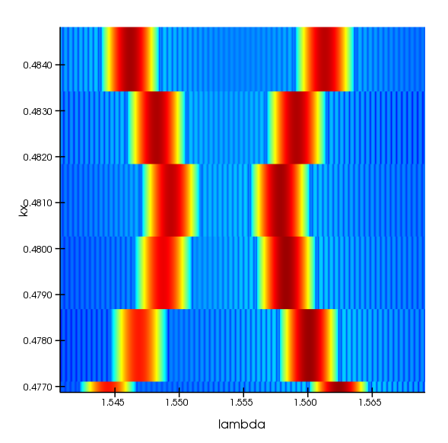
Photonic Band Structure near λ=1550 nm
Δλ = 8.4 nm
λ0 = 1553.5 nm
Contra-Directional
Coupling

Slide 24
What’s happening outside λ=1550 nm?

Slide 25
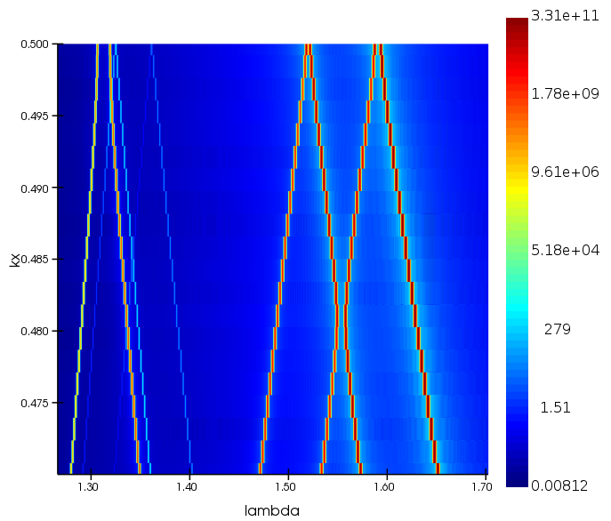
Photonic Band Structure - broadband

Slide 26
Photonic Band Structure - broadband
What’s happening in the
O and E wavelength bands?

Slide 27
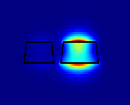
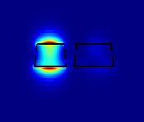
Modes in the system near λ=1310 nm
TM0
TM1
Slot mode

Slide 28
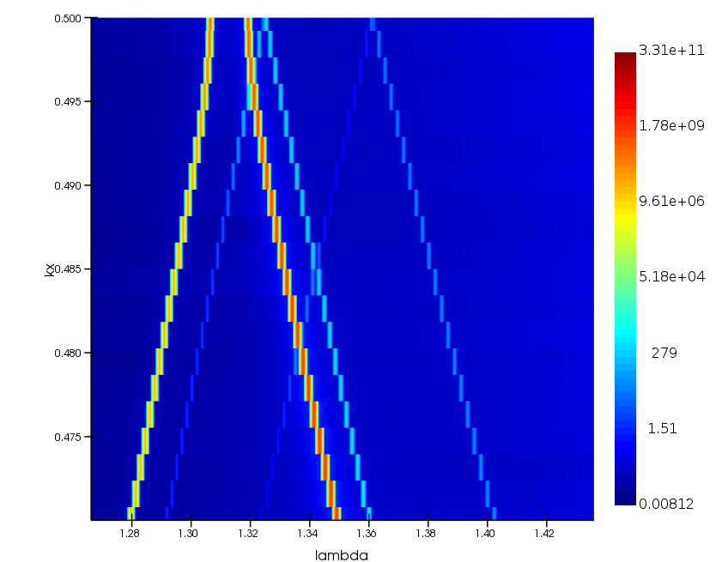
Photonic Band Structure near λ=1310 nm

Slide 29
Photonic Band Structure near λ=1310 nm
TM0

Slide 30
Photonic Band Structure near λ=1310 nm
TM1

Slide 31
Photonic Band Structure near λ=1310 nm
Slot

